Slide 1
Financial Risk Analyst Assessment
By Mike Chanhiran

Slide 2
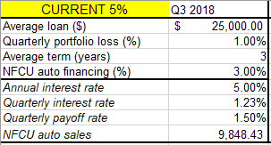
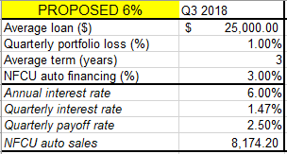
Business Case & Assumptions
Navy Federal is considering raising the interest rate on domestic automobile loans from 5% to 6%
Proposing change in interest rate effects number of loans and payoff rate
Forecasting Model dependent on Macroeconomic data

Slide 3

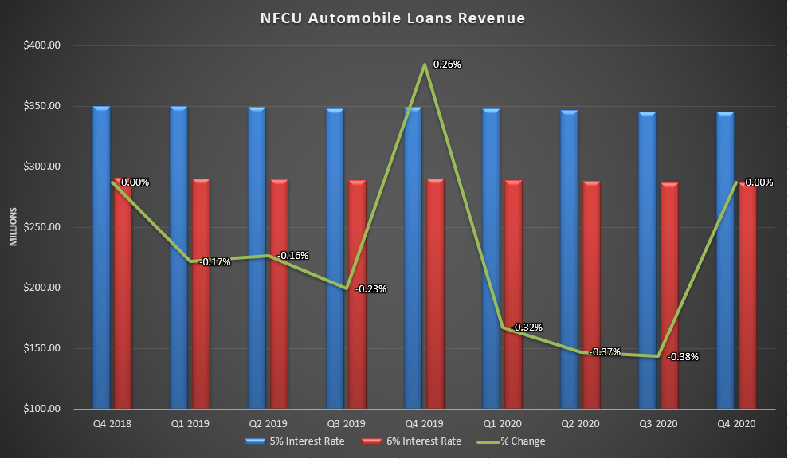
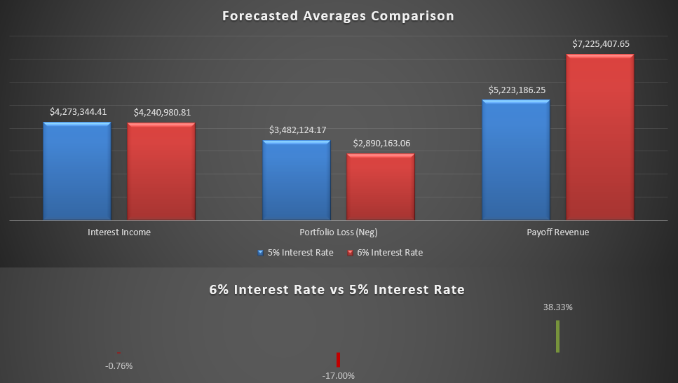
Results & Recommendation
Based on our forecasts Navy Federal should not increase interest rates to 6%
Net Profit Margins are about 44% greater for 6% rate vs the 5% rate

Slide 4
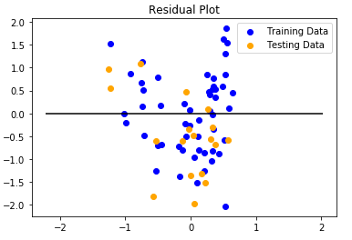
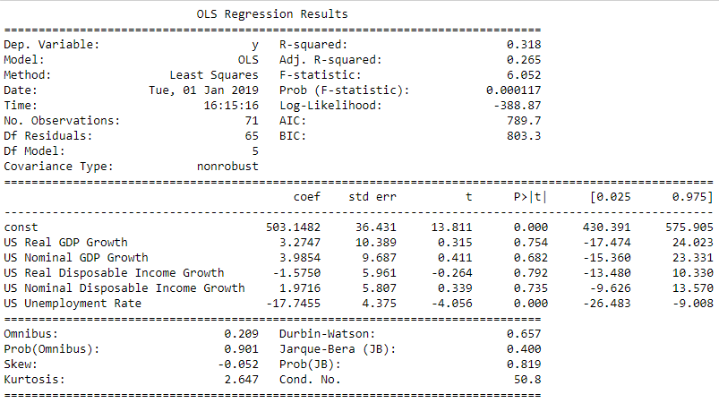
Data and Technologies
Github link: https://github.com/mplusc/FRA
Excel
Python
Pandas
Matplotlib
StatsModel
Scikit-Learn
Regression Model

